Slide 1
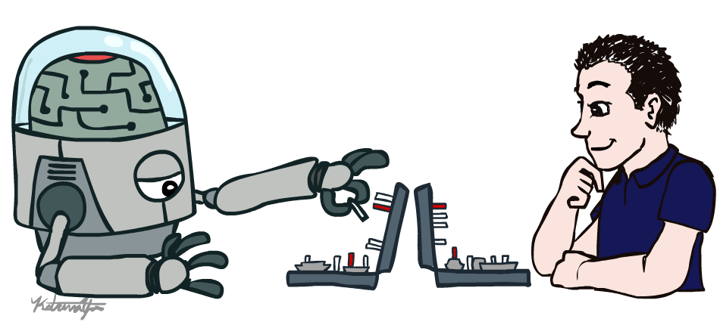
CSE 3521: Introduction to Artificial Intelligence
[These slides are partially adapted from the UC Berkeley. CS188 Intro to AI at UC Berkeley]

Slide 2

Course Information
Instructor:
Jeniya Tabassum (tabassum.13@osu.edu)
Grader:
TBA
Course website:
https://sites.google.com/view/cse-5521sp2021/home
It will have all the slides and recorded lectures

Slide 3
Course Information
Zoom:
For online lectures and office hours and/or exams
Carmen:
For homework submission
Carmen quizzes:
For exams and quizzes
Piazza:
https://piazza.com/class/kjre9a17ts1j
For discussion and announcement

Slide 4
Grading and Homework
Grading Policy
Guidelines
Hands On & participation – 10%
Homework & Labs – 30%
Midterm – 15%
Final – 15%
Final Project – 30%
Expect 3 homework/programming assignments over the course.
Homework submissions are individual, but feel free to discuss.
Project
1-5 person in each group
Need to propose a problem and submit a coding solution

Slide 5
Pre-requisites & What to Expect?
Pre-requisites
Required: CSE 2331 (Foundations 2)
Suggested: MATH 3345 (Foundations of Higher Math), Stat 3460 or 3470 (Intro to Probability and Stats), MATH 2568 (Linear Alg)
Extensive math and programming related Homework
Python (Suggested, but can use any other languages)
AI algorithms often difficult to debug
We strongly recommend that you start early.

Slide 6

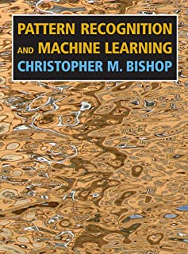
Textbook
Not required, but for students who want to read more we recommend
Warning: Not course textbooks, so our presentation does not necessarily follow the presentation in the book.
Russell & Norvig,
AI: A Modern Approach, 3rd Ed.
Bishop,
Pattern Recognition and Machine Learning

Slide 7
**Important*** This Week
Register
If you are wait-listed, you might or might not get in depending on how many students drop ☹
Math review/self-diagnostic:
Check suggested/require materials
important to check your preparedness for second half

Slide 8
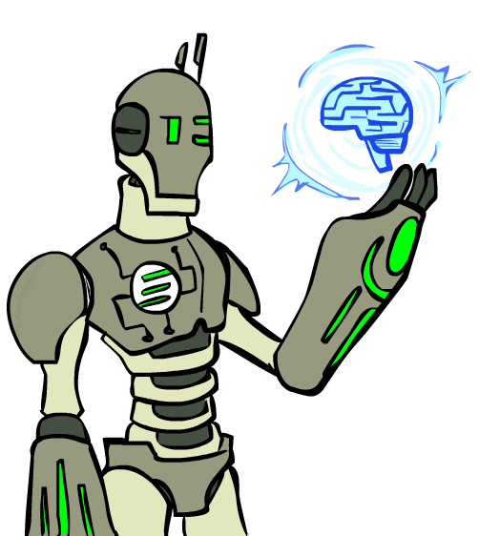
Today
What is artificial intelligence?
What is this course?
What can AI do?
What is an AI agent?
How to evalute an AI agent?

Slide 9
Some Definitions of AI
“The scientific understanding of the mechanisms underlying thought and intelligent behavior and their embodiment in machines”
– American Association of Artificial Intelligence (AAAI)
“Artificial Intelligence is the branch of computer science that is concerned with the automation of intelligent behavior”
– Luger and Stubblefield
“AI strives to understand and build intelligent entities (also helps us to learn more about ourselves)”
– Russell and Norvig

Slide 10
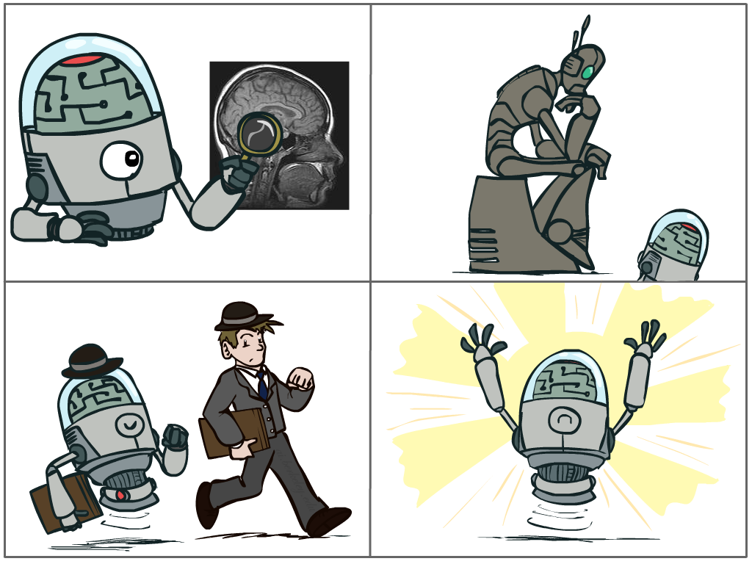
What is AI?
The science of making machines that:
Think like people
Think rationally
Act like people
Act rationally
Notes:
Top left: Think like people --- cognitive science, neuroscience
Bottom left: act like people --- actually very early definition, dating back to Alan Turing --- Turing test; problem to do really well you start focusing on things like don’t answer too quickly what the square root of 1412 is, don’t spell too well, and make sure you have a favorite movie etc. So it wasn’t really leading us to build intelligence
Think rationally – long tradition dating back to Aristotle --- but not a winner, because difficult to encode how to think, and in the end it’s not about how you think, it’s about how you end up acting

Slide 11
What is AI?
Think like people
Think rationally
Act like people
Act rationally
How can we test it?
Notes:
Top left: Think like people --- cognitive science, neuroscience
Bottom left: act like people --- actually very early definition, dating back to Alan Turing --- Turing test; problem to do really well you start focusing on things like don’t answer too quickly what the square root of 1412 is, don’t spell too well, and make sure you have a favorite movie etc. So it wasn’t really leading us to build intelligence
Think rationally – long tradition dating back to Aristotle --- but not a winner, because difficult to encode how to think, and in the end it’s not about how you think, it’s about how you end up acting

Slide 12
The Turing Test
Ingredients:
Human Judge, unknown Entity
2 computer terminals in different room
Recipe:
Have human Judge sit at one computer
Judge converses with Entity via chat window for 5 minutes
Judge decides if Entity is human or computer

Slide 13
Which is Which?
Left hand side
Right hand side
Judge: Hi what’s your name?
Entity: I don’t know
Judge: My name’s Jane. I live in London. Where do you live?
Entity: I live in London as well
Judge: Do you like living in London?
Entity: Yes I like it because there are a lot of things to do and it is the capital city of England
Judge: What’s my name?
Entity: sorry?
Judge: What’s my name?
Entity: Jane
Judge: And what’s your name?
Entity: I don’t know
Judge: What color is the carpet in your room
Entity: I like pink; what do you like?
Judge: I like pink. My name is John. What’s your name?
Entity: Red. Hello John. Its nice to meet such a fine person as yourself.
Judge: Red is my favorite color. What’s yours?
Entity: My favorite color is red.
Judge: You use American spelling. Are you in the USA?
Entity: But you are not even American. Just remember atheism is only a belief system. And it too can be forced on people who don’t agree.
Judge: How do you like your eggs – ever easy or sunny side up?
Entity: How I wonder if I like my eggs-over easy or sunny side up? This is so explainable. That list makes me feel unsure John.
Example taken from “Turing’s Imitation Game,” by Warwick and Shah (2016)

